Slide 1


UNIVERSITY OF BASRA
COLLEGE OF MEDICINE
DEPARTMENT OF PATHOLOGY AND FORENSIC Medicine
White blood cells
Part I
Dr. Ala’a A.Razak Abood
Iraqi Board of Haematopathology

Slide 2
objectives:
Know the normal components of white blood cells, development, their normal level and physiological functions.
The benign disorders of WBCs: including abnormalities in function and number.
Leukemia: definition, pathogenesis, clinical features and diagnosis.

Slide 3
WBC
WBC
WBC
phagocytes
phagocytes
lymphocytes
lymphocytes
Granulocytes
Monocytes
Granulocytes
Monocytes
Neutrophils
Basophils
Eosinophils

Slide 5
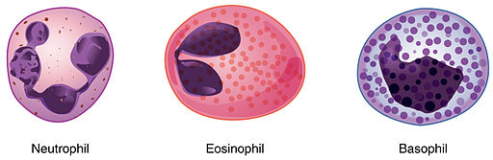
Granulocytes

Slide 6
Neutrophil
Eosinophil
Basophil

Slide 7
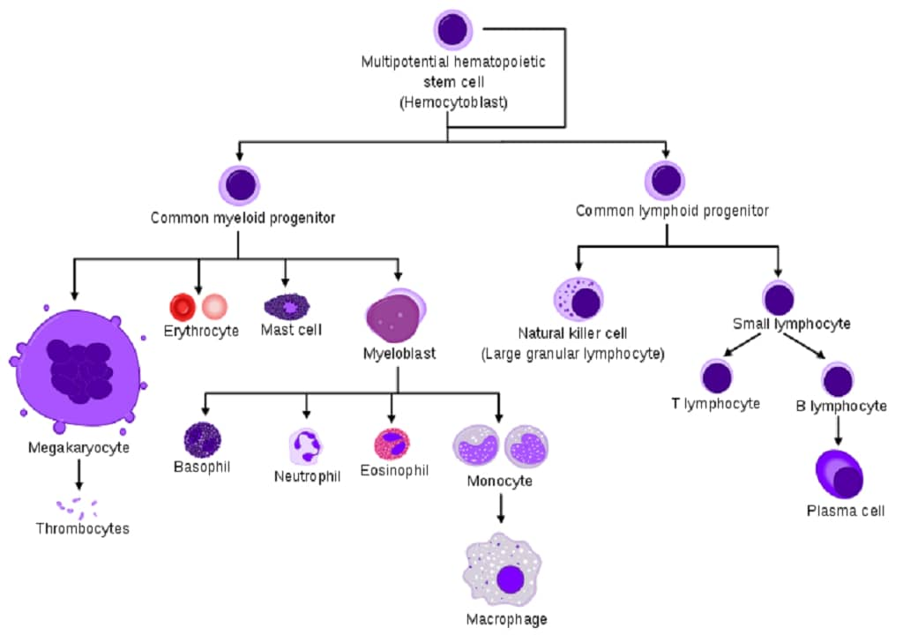

Slide 8
Granulopoiesis:

Slide 9
Control of granulopoiesis:

Slide 10

List the clinical application of G-CSF

Slide 11
Monocytes

Slide 12
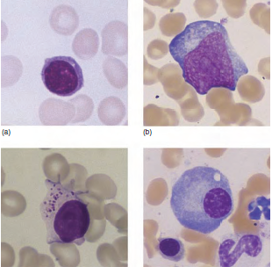

Slide 13
WBC disorders
Benign
Malignant
Numbers
Function
Neutrophilia
Neutropenia
Monocytosis
Lymphocytosis

Slide 14
WBC disorders
Benign
Malignant
Leukemia
Lymphoma
Myeloproliferative disorders
Myelodysplastic syndrome

Slide 15

Neutrophil Count Disorders

Slide 16
Neutrophilia:
Definition:
An increase in circulating neutrophils to levels greater than 7.5 × 109/L.
Is one of the most frequently observed blood count changes.

Slide 17
Causes :

Slide 18
Neutropenia:
- The lower limit of the normal neutrophil count is 1.8 × 109/L
except in black people and in the Middle East where 1.5 × 109/L
is normal.
- Neutropenia may be selective or part of a general pancytopenia

Slide 19
Causes :
Congenital
Acquired
1- Drug‐induced
2- Benign (racial or familial)
3- Cyclical
4- Immune
5- Infections

Slide 20
Lymphocytosis:

Slide 21
Infectious Mononucleosis:

Slide 22


Slide 23
Definition:
The leukaemias are a group of disorders characterized by the accumulation of malignant white cells in the bone marrow and blood.

Slide 24
Aetiology:
Inherited factors
Environmental factors:
1- chemicals.
2- drugs.
3- radiation
4- Infection.

Slide 25
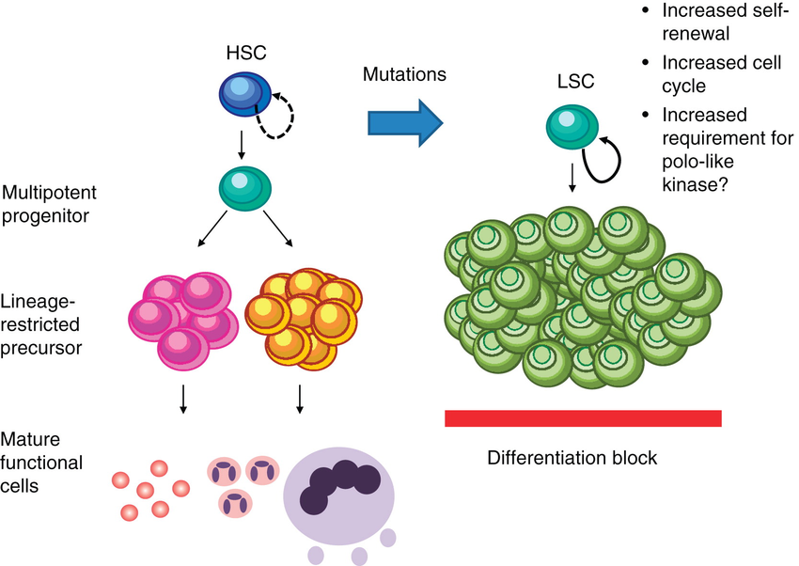
Pathogenesis:

Slide 26
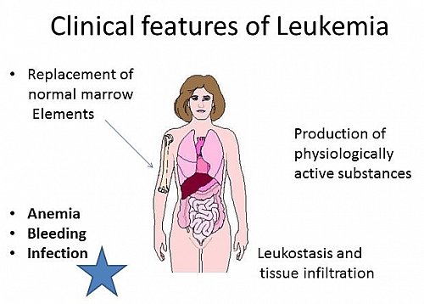
Clinical Features:

Slide 27
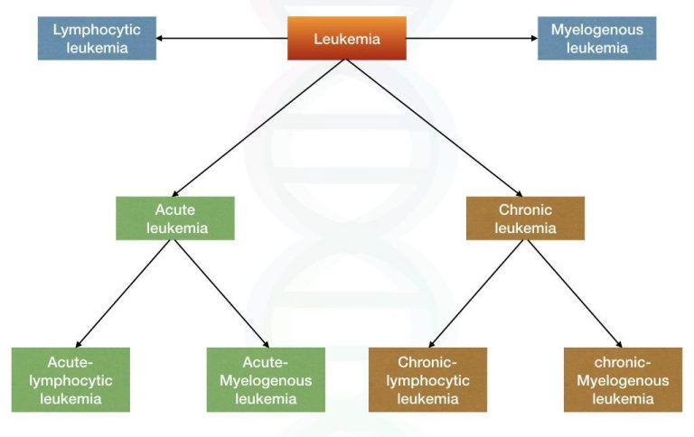
Classification:

Slide 28
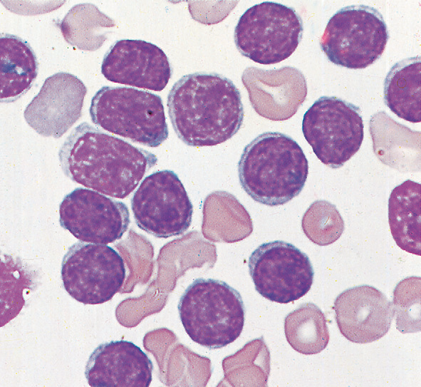
Diagnosis :
Morphological examination (Microscopically )

Slide 29
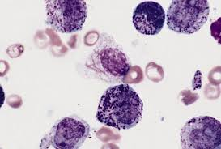
Cytochemistry

Slide 30
Immunophenotyping (flow cytometry)

Slide 31
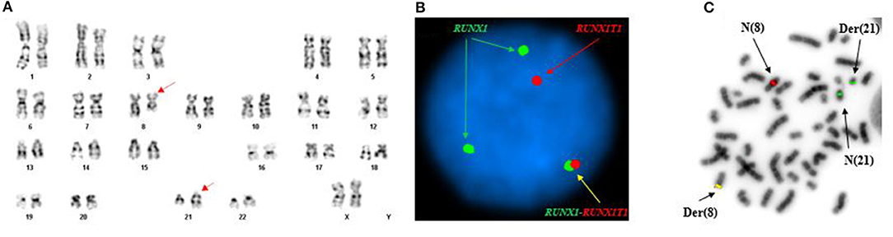
Molecular and cytogenetic study:

Slide 32


